Slide 1
Introduction to Deep Learning
Basics of Artificial Neural Networks

Slide 2
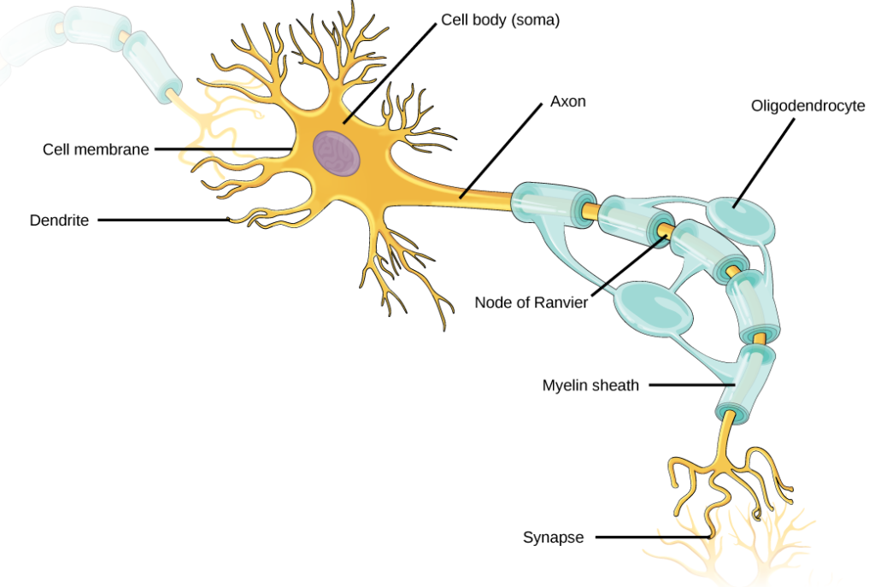
Biological Neural Networks
Several neurons are connected to one another to form a neural network or a layer of a neural
network.
3

Slide 3
Feed Forward Neural Networks (FFNN)

Slide 4
Neuron with Threshold Logic Activation Function
Activation
Output signal
Input Weights
w₁
w₂
value
x₁ x₂
d
∑w_{i}x_{i}-θ
i=1
a
s=f(a)
w_{d}
x_{d}
Threshold logic activation function
•
McCulloch-Pitts Neuron

Slide 5
Linearly Separable Classes
Regions of two classes are separable by a linear surface (line, plane or hyperplane)
Perceptron model that uses a single MuCulloch-Pitts neuron can be trained using the perceptron learning algorithm
Decision surface in a 2-dimensional
space is a line:
w₁ x₁ + w₂ x₂ + w₀ = 0
x₂
x = − ^{w1} x − ^{w0}
2 1
w₂ w₂
Decision surface in a d-dimensional space is a hyperplane:
d
∑
i=0
t
x₁
w x = w x =
0
i i
6

Slide 6
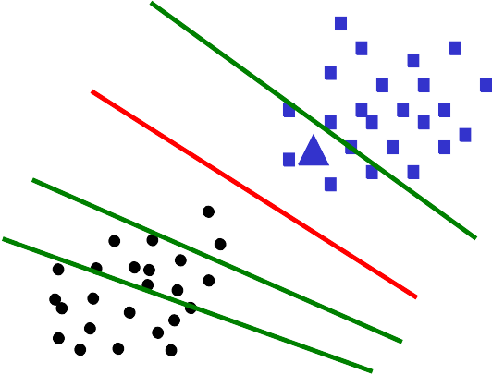
Perceptron Learning
Perceptron learning rule for weight update:
At Step m, choose a training example x(m).
w(m +1) = w(m) +η x(m), for w(m) x(m) ≤ 0 and x(m) ∈C₁
t
w(m +1) = w(m) −η x(m), for w(m) x(m) > 0 and x(m) ∈C₂
t
Here η is the learning rate parameter.
x₂
Classification of a test pattern x
using the weights w obtained by training the model :
If w^{t}x > 0 then x is assigned to C₁
If w^{t}x ≤ 0 then
x is assigned to C₂
x₁

Slide 7
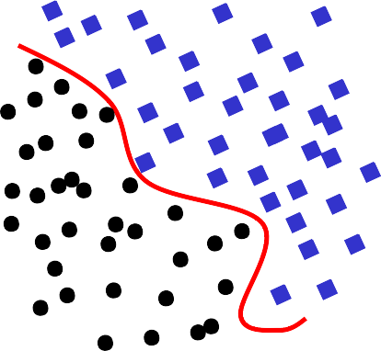
Hard Problems
Nonlinearly separable classes
x₂
x₁

Slide 8
Neuron with Continuous Activation Function
Input Weights
w₁
w₂
Activation
Output signal
value
x₁ x₂
d
∑w_{i}x_{i}-θ
i=1
a
s=f(a)
w_{d}
x_{d}
Sigmoidal activation function
Sigmoidal Neuron

Slide 9
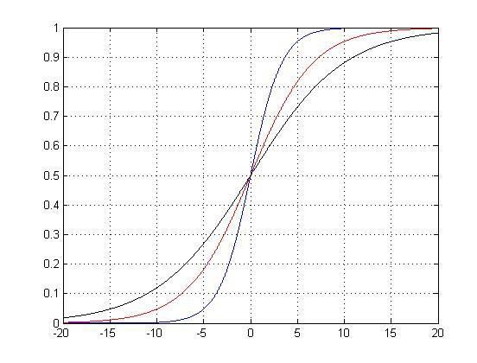
Sigmoidal Activation Functions
.0
Logistic function:
Range of output is 0.0 to 1
β = 0.6
β = 0.2
1
β = 0.3
f (a) =
f(a)
_{1+ e}−βa
^{df (a)} = βf (a)(1− f (a))
da
Hyperbolic tangent function:
Range of output is -1.0 to 1.0
f (a) = tanh( βa)
a
^{df (a)} = β (1− f ² (a))
da
Logistic function and Hyperbolic tangent functions can be used in hidden layers and output layer
10

Slide 10
Softmax Activation Function
Softmax activation function:
•
•
•
Used in the output layer only
Used for multi-class pattern classification tasks
Outputs of softmax neurons are in the range 0.0 to 1.0, and add up to 1.0
Outputs of softmax neurons can be interpreted as probabilities for classes
•
•
•
•
Let K be the number of classes
Let 𝑎_{𝑗} , 𝑗 = 1, 2, … . , 𝐾, be the activation value for the node of class 𝑗.
Then the output of kth node is given by
_{𝑒}𝑎_{𝑘}
𝑠_{𝑘} = _{𝐾}
_{𝑒}𝑎_{𝑗}
𝑗=1
•
The following can be derived:
𝜕𝑠_{𝑘}
= 𝑠_{𝑘} 1 − 𝑠_{𝑘}
𝜕𝑎_{𝑘}
𝜕𝑠
𝑘
= −𝑠 𝑠
𝜕𝑎_{𝑗}
𝑘 𝑗

Slide 11
Rectilinear Activation Function
Rectilinear activation function:
•
Used in the hidden layers only (mainly in convolutional neural networks)
Can not be used in the output layer
Nodes with rectilinear activation function are called as Rectilinear Units (ReLU)
•
•
𝑓 𝑎
•
No saturating region in the activation function
𝑓 𝑎 = max 0, 𝑎
𝑎
𝑑𝑓 𝑎
= 1, for 𝑎 > 0
𝑑𝑎

Slide 12
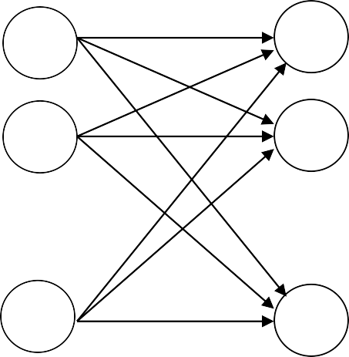








Multilayer Feedforward Neural Network
Architecture:
Input layer ---- Linear neurons
One or more hidden layers ---- Nonlinear neurons
Output layer ---- Linear or nonlinear neurons
Actual Output
Desired Output
Input
x₁
x₂
.
.
.
x_{i}
.
.
.
x_{d}
Input Layer
Hidden Layer
Output Layer
1
2
.
.
.
i
.
.
.
1
2
.
.
.
j
.
.
.
1
2
.
.
.
k
.
.
.
d
J
K

Slide 13

Computations in Forward Pass
x_{i}
s_{i} = x_{i}
h
o
s_{j}
s_{k}
i
j
k
_{w}h
^{w}jk
ij
_{s}h
= f ^{h} (a^{h} )
j j
j
d
h j
= ∑ w s −θ , where s_{i}
a
h h
= x_{i}
ij i j
i=1
_{s}o
= f º (aº )
k k
k
J
= ∑ w s^{h} −θ º
j =1
_{a}o
k
jk j
k
⎡
J
⎛
d
⎞
⎤
⎥
⎦
o k
∑ jk j
h
∑ ji i
h
j
_{s}o
h
o k
= f
⎢
w f ⎜
w s −θ ⎟ −θ
⎠
k
⎝ i=1
⎣ j =1
14

Slide 14
Gradient Descent Method
Local minimum
Error
Local minimum
Global minimum
Weight

Slide 15
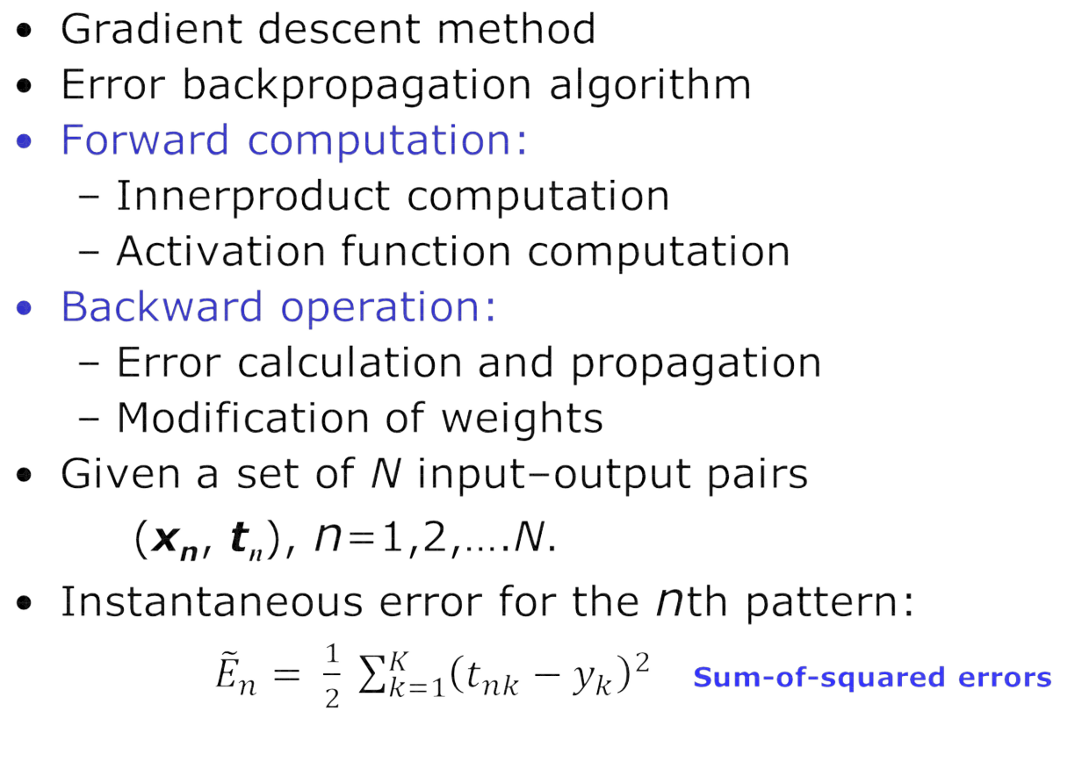
Backpropagation Learning

Slide 16
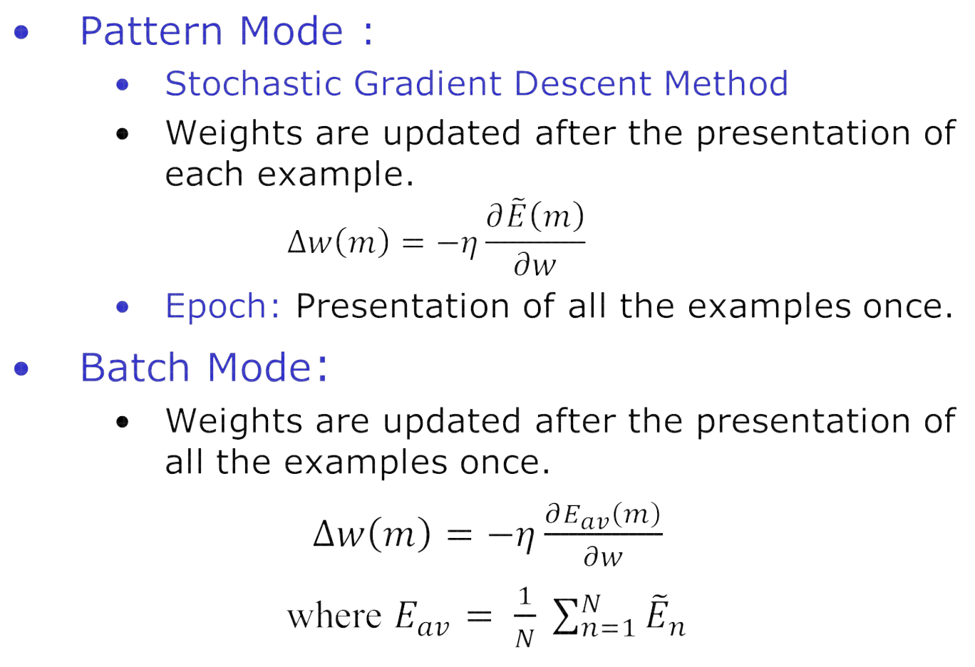
Modes of Learning

Slide 17
Modes of Learning
Mini-Batch Mode:
– The training dataset of N examples is divided into M subsets, with approximately same number of examples in each subset.
– Weights
are updated after the presentation of
examples in the subset (mini-batch)
– It is empirically shown that the mini-batch mode is more effective than the pattern mode and batch mode.

Slide 18
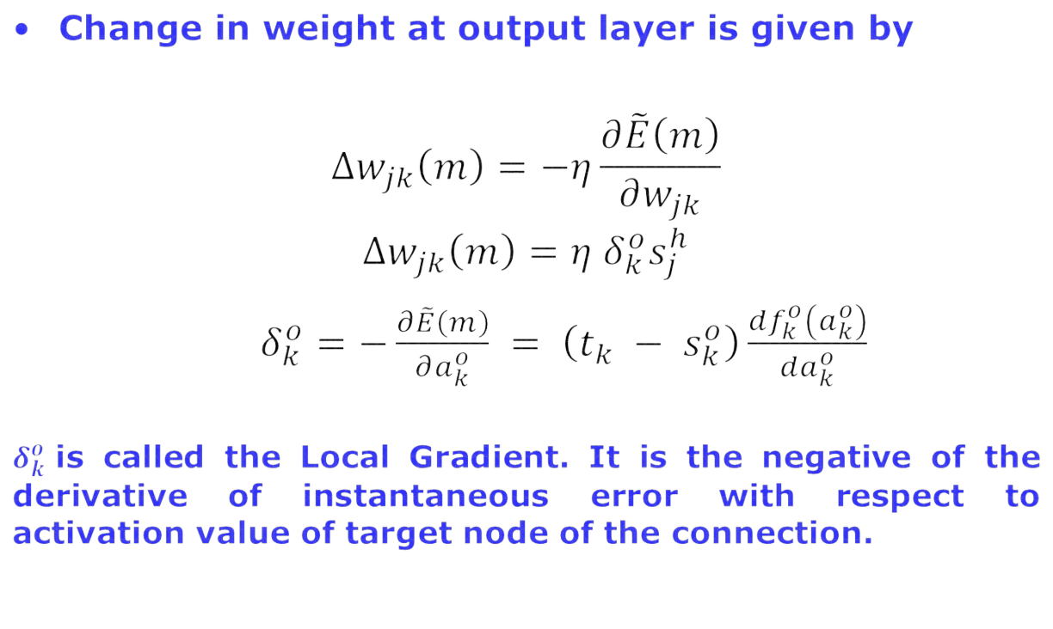
Backpropagation Learning (contd.)
x_{i}
s_{i} = x_{i}
h
o
s_{j}
s_{k}
i
j
k
_{w}h
^{w}jk
ij
It can be shown that these two are equal
Activation value
Target

Slide 19
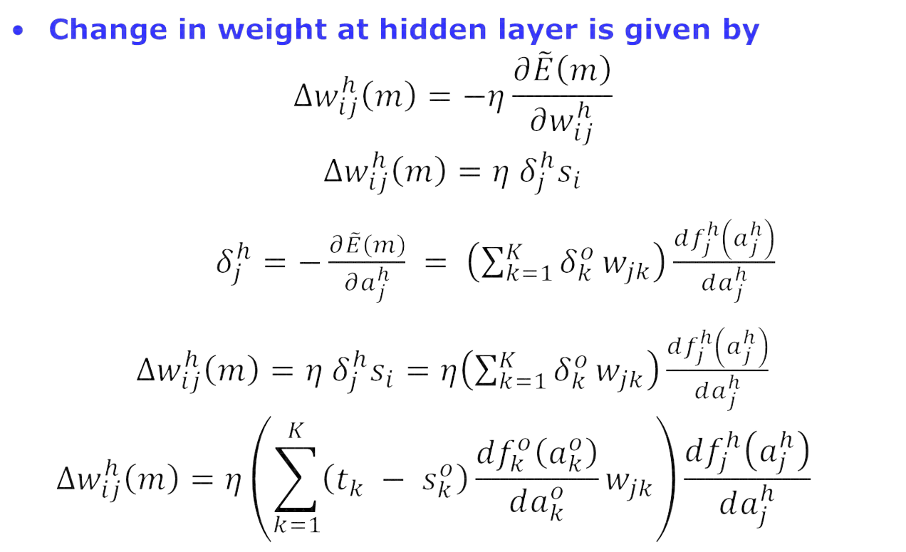
Backpropagation Learning (contd.)
s_{i} = x_{i}
^{w}ij
h o
s_{j} s_{k}
i
j
k
x_{i}
h
^{w}jk
𝑠_{𝑖}
𝑠_{𝑖}
20

Slide 20
Practical Considerations
Stopping Criterion:
Threshold on average error
Threshold on average gradient
Number of Weights:
Depends on number of input nodes, output nodes, hidden nodes
Number of Hidden Nodes
Cross-validation method
Data Requirements
Limitations:
Slow convergence
Local minima problem

Slide 21
Feedforward Neural Networks: Summary
Perceptrons, with threshold logic function as activation function, are suitable for pattern classification tasks that involve linearly separable classes.
•
Multilayer feedforward neural networks, are suitable for pattern classification tasks that involve nonlinearly separable classes.
Complexity of the model to be used for a given task depends on
Dimension of the input pattern vector
Number of classes
Shapes of the decision surfaces to be formed
Architecture of the model is empirically determined
Large number of training examples are required when the complexity of the model is high
Local minima problem
Multilayer feedforward neural network with one or two hidden layers is now called a shallow network.
Multilayer feedforward neural network with more than two hidden layers is called a Deep Feedforward Neural Network (DNN).

